Slide 1
SAN JOSE CREEK
MULTI-USE BIKEWAY PROJECT
Presented by:
Arnold Dichosa, City Engineer (Ingeniero dela Ciudad)
Steven Frieson, COO & Project Manager (Gerente de Proyecto)
ALTA Planning & Design

Slide 2
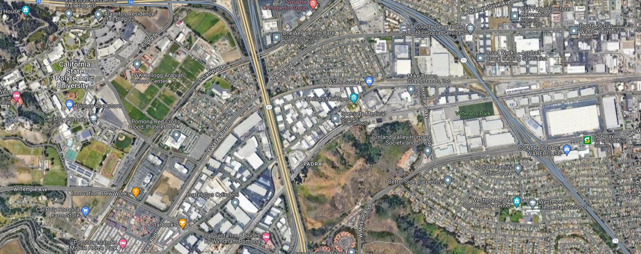
71 FWY
57 FWY
COMMUNITY
COMMERCIAL BUSINESSES
CAL POLY UNIVERSITY
COMMUNITY
UNION PACIFIC RAILROAD
COMMUNITY
SOCCER FIELDS
PROJECT LOCATION
COMMERCIAL BUSINESSES
COMMUNITY
COMMUNITY
71 FWY
CAL POLY OFF- CAMPUS APTS
UNION PACIFIC RAILROAD
57 FWY
ELEMENTARY SCHOOL AND PARK

Slide 3
71 FWY
57 FWY
COMMUNITY
COMMERCIAL BUSINESSES
CAL POLY UNIVERSITY
COMMUNITY
In October 2021, the City of Pomona completed the construction of the Valley Boulevard (Class 4) protected bike lane. The limits of the bike lane are from Temple Ave to Humane Way.
UNION PACIFIC RAILROAD
COMMUNITY
SOCCER FIELDS
PROJECT LOCATION
COMMERCIAL BUSINESSES
COMMUNITY
COMMUNITY
71 FWY
CAL POLY OFF- CAMPUS APTS
UNION PACIFIC RAILROAD
57 FWY
ELEMENTARY SCHOOL AND PARK

Slide 4
Presently, the City is completing design for the new 3.2 mile pedestrian and bike trail along the San Jose Creek. The bike and pedestrian trails limits are from Temple Ave to Murchison St (by the 10 fwy). The project is fully funded, as construction is anticipated to begin June 2025.
This bike and pedestrian trail will connect many people to parks, schools, and communities to the north portion of Pomona as there will be access to the trail/bikeway throughout its limits.
71 FWY
57 FWY
COMMUNITY
COMMERCIAL BUSINESSES
CAL POLY UNIVERSITY
COMMUNITY
UNION PACIFIC RAILROAD
COMMUNITY
SOCCER FIELDS
PROJECT LOCATION
COMMERCIAL BUSINESSES
COMMUNITY
COMMUNITY
71 FWY
CAL POLY OFF- CAMPUS APTS
UNION PACIFIC RAILROAD
57 FWY
ELEMENTARY SCHOOL AND PARK

Slide 5
2. In addition to the ongoing improvements in connecting vital neighborhoods, Caltrans will be constructing a key pedestrian and bike bridge across the SR71 fwy. The location will connect Ninth Street, as Ninth Street has access to the Westmont Elementary School and Westmont Park & Community Center on the west side of the SR71. Bridging the communities.
1. Ridgeway St, between Valley Bl and S. Campus Drive has been designed with Class 2 bike lanes. This bike connection links cyclists to access the San Jose Creek Ped and Bike way.
71 FWY
57 FWY
COMMUNITY
COMMERCIAL BUSINESSES
CAL POLY UNIVERSITY
COMMUNITY
UNION PACIFIC RAILROAD
COMMUNITY
3. As part of the City’s ATP Plan (Ped and Bike Master Plan), the City received ATP Cycle 4 funding to design and construct Humane Way to have Class 2 bike lanes and pedestrian walkways from Mission Bl to Valley Bl, while maintaining 4 lanes of traffic. Construction is scheduled to be completed by December 2025.
SOCCER FIELDS
PROJECT LOCATION
COMMERCIAL BUSINESSES
COMMUNITY
COMMUNITY
71 FWY
CAL POLY OFF- CAMPUS APTS
UNION PACIFIC RAILROAD
57 FWY
ELEMENTARY SCHOOL AND PARK

Slide 6
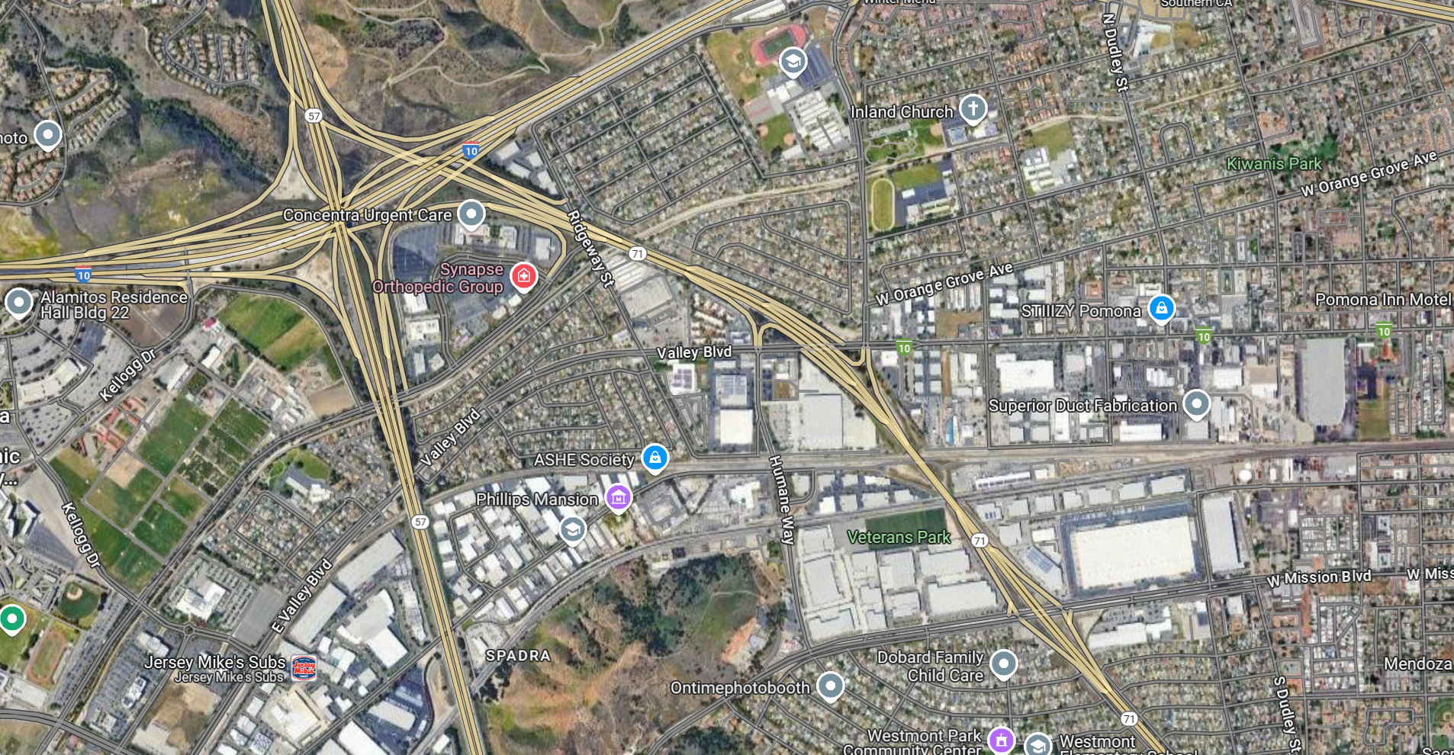
3.5 mile long walking trail & bike path running adjacent with the San Jose Creek
Sendero para caminar y carril bici de 3 punto 5 millas de largo que corre junto al arroyo San José
Temple Ave @ S Campus Dr
Murchison Ave @ Casa Vista Dr

Slide 7
Project Funding:
Design (diseño) - 2019 City received $1.4M from Measure M (Multi-Year Subregional Program) En el ano 2019 las ciudad recibio $1.4M medida M (Programa Subregional Plurianual)
- 2021 City advertised for Design services
Ciudad 2021 anunciada para servicios de diseño
- 2022 City awarded to ALTA Planning + Design
Ciudad 2022 adjudicada a ALTA Planning + Design

Slide 8
Project Funding (continued)
Construction (construcción) - 2023 City received $11.3M of ATP C6 funding from LAC Metro to fully fund this bikeway project. 2023 La ciudad recibió $11.3 millones de fondos ATP C6 de LAC Metro para financiar completamente este proyecto de ciclovía.

Slide 9

San Jose Creek Multi-Use Bikeway Project
Steven Frieson, Project Manager (Gerente de Proyecto)
Team ALTA Planning

